Slide 1
463.6.1 Trusted Computing
Computer Security II
CS463/ECE424
Presented by Hyun Bin Lee
University of Illinois

Slide 2
Outline
Trusted Platform Module (TPM)
Secure Enclaves (SGX)
MP3

Slide 3
History of Tamper Resistance
History of Tamper Resistance goes back centuries
Examples:
Weight down code books on naval ships
Codes and, more recently, the keys for wartime cipher machines have been printed in water soluble ink
IBM 3848 and the VISA security module (1980s)
Motivation of Secure Hardware:
Prevent powerful adversaries from getting secret
Notes:
Weight down code books on naval ships (back to ancient times)
Codes and, more recently, the keys for wartime cipher machines have been printed in water soluble ink
IBM 3848 and VISA security module:
Both of these were microcomputers encased in robust metal enclosures, with encryption hardware and special key memory, which was static RAM designed to be zeroized when the enclosure was opened. This was accomplished by wiring the power supply to the key memory through a number of lid switches. So whenever the maintenance crew came to replace batteries, they’d open the lid and destroy the keys.

Slide 4
463.6.1.1
Trusted Platform Module (TPM)
Based on Slides by Stalling and Brown

Slide 5





Trusted Computing
Trusted Computing is the term developed by the Trusted Computing Group (TCG)
Trusted Computing allows “a piece of data to dictate what Operating System and Application must be used to open it”
Notes:
TCG is a consortium founded in 1999 with a large number of companies
Quote from:
https://cs.stanford.edu/people/eroberts/cs201/projects/trusted-computing/what.html

Slide 6
Trusted Platform Module (TPM)
hardware module at heart of hardware/ software approach to Trusted Computing
uses a TPM chip
has three basic services:
  authenticated boot, certification, encryption
Notes:
The trusted platform module (TPM) is a concept being standardized by an industry
consortium, the Trusted Computing Group.
The TPM is a hardware module that
is at the heart of a hardware/software approach to trusted computing. Indeed, the
term trusted computing (TC) is now used in the industry to refer to this type of
hardware/software approach.
The TC approach employs a TPM chip in personal computer motherboard
or a smart card or integrated into the main processor, together with hardware and
software that in some sense has been approved or certified to work with the TPM.
We can briefly describe the TC approach as follows. The TPM generates keys that
it shares with vulnerable components that pass data around the system, such as
storage devices, memory components, and audio/visual hardware. The keys can be
used to encrypt the data that flow throughout the machine. The TPM also works
with TC-enabled software, including the OS and applications. The software can be
assured that the data it receives are trustworthy, and the system can be assured that
the software itself is trustworthy.
To achieve these features, TC provides three basic services: authenticated
boot, certification, and encryption.

Slide 7
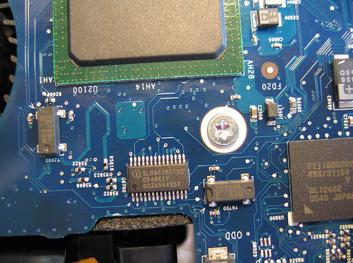
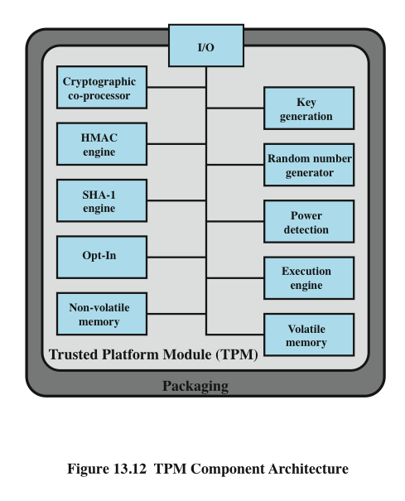
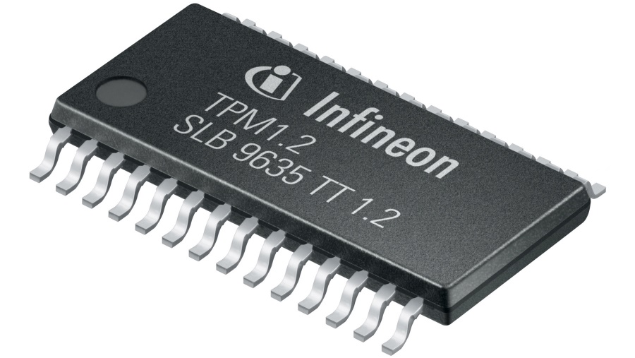
TPM Functions
Notes:
PCR: Platform Configuration Counters → registers that cryptographically record (measure) software state
Figure 13.12 , based on the most recent TPM specification, is a block diagram of the
functional components of the TPM. These are as follows:
• I/O: All commands enter and exit through the I/O component, which provides
communication with the other TPM components.
• Cryptographic co-processor: Includes a processor that is specialized for
encryption and related processing. The specific cryptographic algorithms
implemented by this component include RSA encryption/decryption,
RSA-based digital signatures, and symmetric encryption.
• Key generation: Creates RSA public/private key pairs and symmetric keys.
• HMAC engine: This algorithm is used in various authentication protocols.
• Random number generator (RNG): This component produces random numbers
used in a variety of cryptographic algorithms, including key generation, random
values in digital signatures, and nonces. A nonce is a random number used once,
as in a challenge protocol. The RNG uses a hardware source of randomness
(manufacturer specific) and does not rely on a software algorithm that produces
pseudo random numbers.
SHA-1 engine: This component implements the SHA algorithm, which is used
in digital signatures and the HMAC algorithm.
• Power detection: Manages the TPM power states in conjunction with the
platform power states.
• Opt-in: Provides secure mechanisms to allow the TPM to be enabled or
disabled at the customer/user’s discretion.
• Execution engine: Runs program code to execute the TPM commands
received from the I/O port.
• Nonvolatile memory: Used to store persistent identity and state parameters
for this TPM.
• Volatile memory: Temporary storage for execution functions, plus storage
of volatile parameters, such as current TPM state, cryptographic keys, and
session information.

Slide 8
Secure/Authenticated Boot Service
Boot Loader
OS Kernel
Kernel module
…

Slide 9

Secure/Authenticated Boot Service
Q: How can we verify that our boot loader is not tampered?
Boot Loader
Boot Loader
?

Slide 10
Secure/Authenticated Boot Service
A: Hashing!
!=
Boot Loader
Boot Loader
SHA-1( )
SHA-1( )
!

Slide 11
Secure/Authenticated Boot Service
Q: How can we verify Boot Loader and OS Kernel are both not tampered?
Boot Loader
OS Kernel

Slide 12
Secure/Authenticated Boot Service
SHA-1( || )
Boot Loader
OS Kernel
SHA-1( )
SHA-1( )

Slide 13
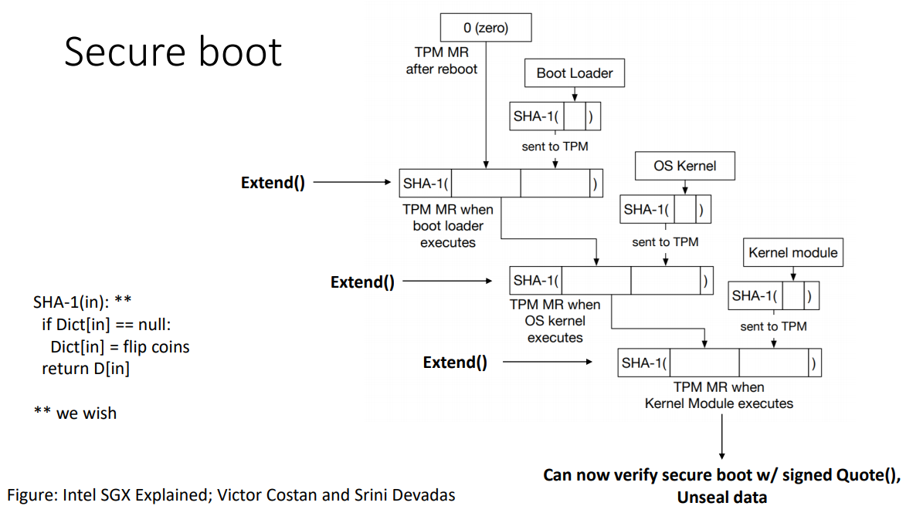
Secure/Authenticated Boot Service
Notes:
Store each extend values to non-volatile storages called Platform Configuration registers (PCRs)

Slide 14


Certification Service
once a configuration is achieved and logged, the TPM can certify configuration to others (Attestation)
challenge value in certificate assures timeliness
why TPM need to assign the cert for the configuration,
It should have mechanism to assure the correctness of OS
provides a hierarchical certification approach
TPM
OS
Application
Notes:
Once a configuration is achieved and logged by the TPM, the TPM can certify the
configuration to other parties.
The TPM can produce a digital certificate by signing
a formatted description of the configuration information using the TPM’s private
key.
Thus, another user, either a local user or a remote system, can have confidence
that an unaltered configuration is in use because
1. The TPM is considered trustworthy. We do not need a further certification of
the TPM itself.
2. Only the TPM possesses this TPM’s private key. A recipient of the configuration
can use the TPM’s public key to verify the signature ( Figure 2.7b ).
To assure that the configuration is timely, a requester issues a “challenge” in
the form of a random number when requesting a signed certificate from the TPM.
The TPM signs a block of data consisting of the configuration information with
the random number appended to it. The requester therefore can verify that the
certificate is both valid and up to date.
The TC scheme provides for a hierarchical approach to certification. The
TPM certifies the hardware/OS configuration. Then the OS can certify the presence
and configuration of application programs. If a user trusts the TPM and trusts the
certified version of the OS, then the user can have confidence in the application’s
configuration.

Slide 15
Encryption Service
encrypts data so that it can only be decrypted by a machine with a certain configuration
TPM maintains a master secret key unique to machine
How could protect the secret key!
can extend scheme upward
Notes:
The encryption service enables the encryption of data in such a way that the data
can be decrypted only by a certain machine and only if that machine is in a certain
configuration. There are several aspects of this service.
First, the TPM maintains a master secret key unique to this machine. From
this key, the TPM generates a secret encryption key for every possible configuration
of that machine. If data are encrypted while the machine is in one configuration, the
data can only be decrypted using that same configuration. If a different configuration
is created on the machine, the new configuration will not be able to decrypt the
data encrypted by a different configuration.
This scheme can be extended upward, as is done with certification. Thus, it is
possible to provide an encryption key to an application so that the application can
encrypt data, and decryption can only be done by the desired version of the desired
application running on the desired version of the desired OS. These encrypted data
can be stored locally, only retrievable by the application that stored them, or transmitted
to a peer application on a remote machine. The peer application would have
to be in the identical configuration to decrypt the data.
The encryption of a file proceeds in an analogous matter. In this latter case,
a process requests a symmetric key to encrypt the file. The TPM then provides an
encrypted version of the key to be stored with the file.

Slide 16
Example: Windows BitLocker Drive Encryption
Windows 10 Operating System uses TPM on multiple components including its drive encryption
BitLocker relies on the TPM to allow the use of a key only when startup occurs in an expected way
Volume remains confidential when:
- Different OS booted from USB device
- Hard disk is lost or stolen when powered off
Notes:
https://docs.microsoft.com/en-us/windows/security/information-protection/tpm/how-windows-uses-the-tpm

Slide 17
Criticisms against TPM
The concept of Trusted Computing is developed and promoted by the Trusted Computing Group.
Root of trust
Anti-competitive effect

Slide 18


Slide 19
463.6.1.2
Secure Enclaves
Based on Slides from
Intel SGX (Reference Number: 332680-002) presented at ISCA 2015
Intel’s SGX In-depth Architecture by Syed Kamran Haider with Hamza Omar, Masab Ahmad, Chenglu Jin, and Marten van Dijk

Slide 20
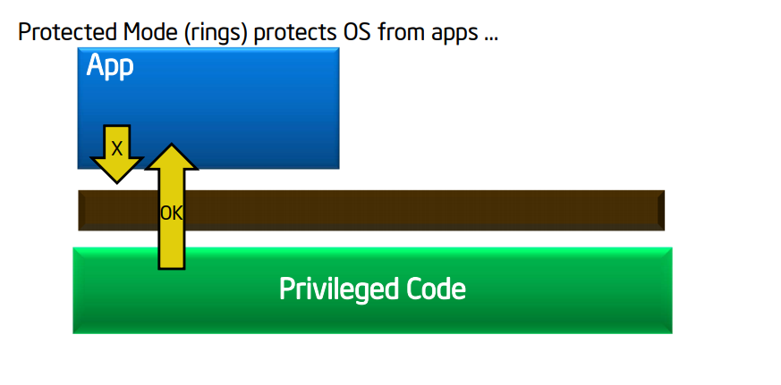
Why Aren’t Compute Devices Trustworthy?

Slide 21
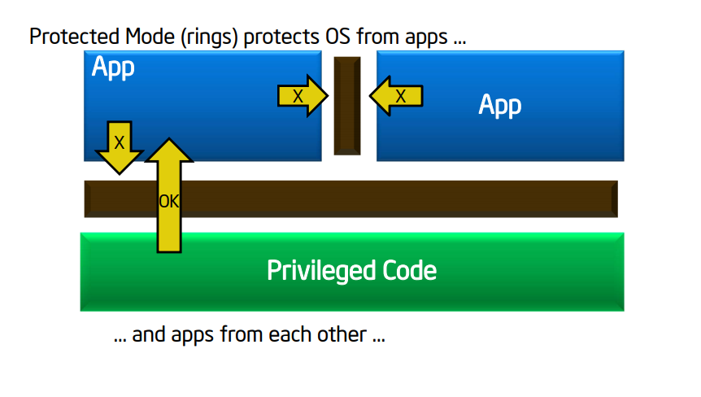
Why Aren’t Compute Devices Trustworthy?

Slide 22
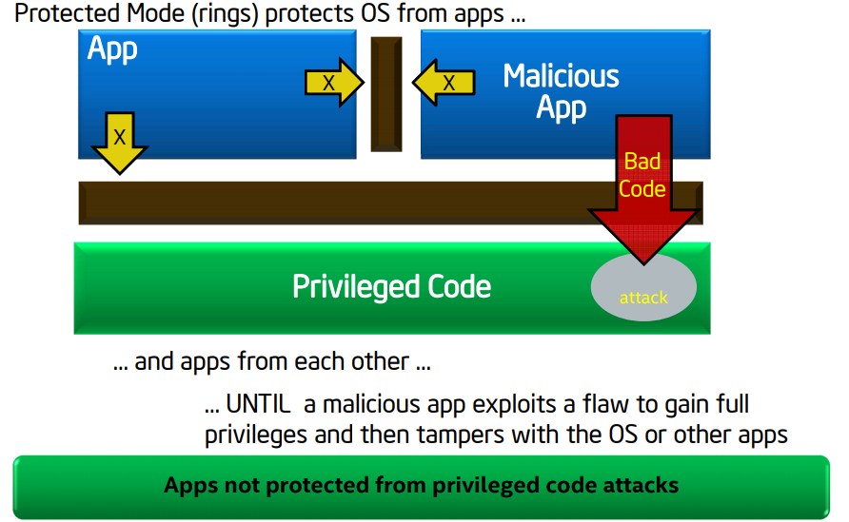
Why Aren’t Compute Devices Trustworthy?

Slide 23
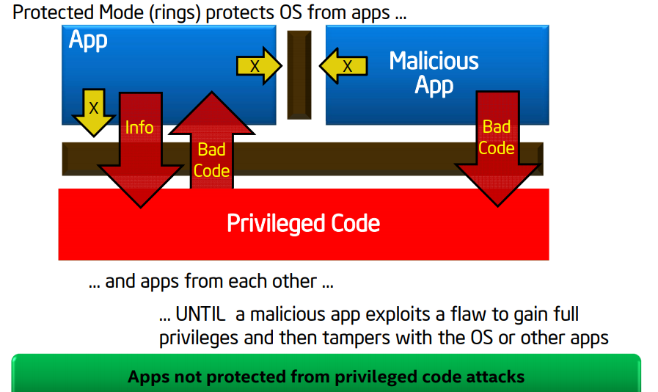
Why Aren’t Compute Devices Trustworthy?

Slide 24
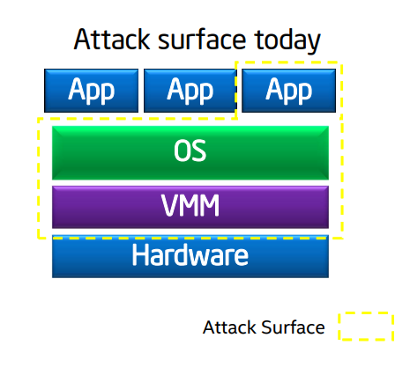
Reduced Attack Surface with SGX
Complexity of modern systems force programmers to inspect a large code base for vulnerability detections.
Application code
OS code
Virtual Machine Manager Code

Slide 25
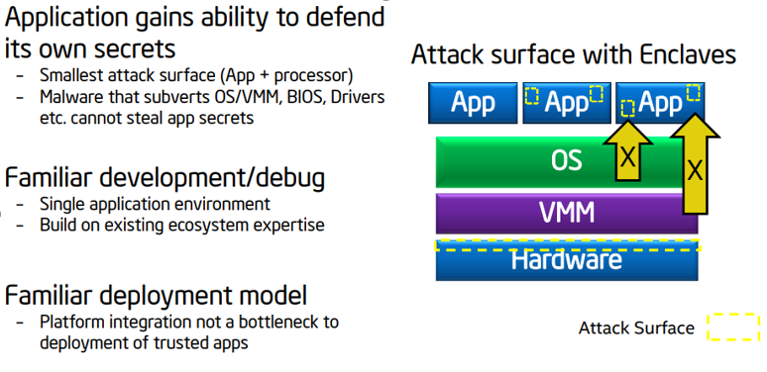
Reduced attack surface with SGX
Intel becomes the root of trust in this security model.

Slide 26
Isolation and Attestation
SGX enabled processors offer two crucial properties.
Isolation: Each enclave’s environment is isolated from the untrusted software outside the enclave, as well as from other enclaves.
Attestation: A software attestation scheme that allows a remote party to authenticate the software running inside an enclave.
We will focus on the isolation property for the remainder of the lecture.

Slide 27
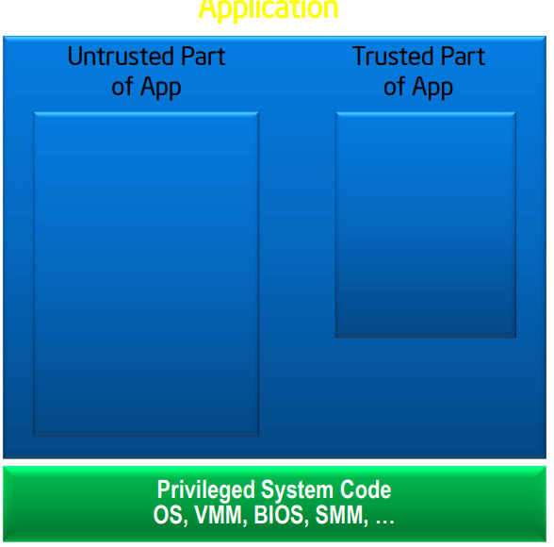
How Secure Enclaves Work
Application is built with trusted and untrusted parts
Trusted and untrusted parts are explicitly separated by app developers

Slide 28
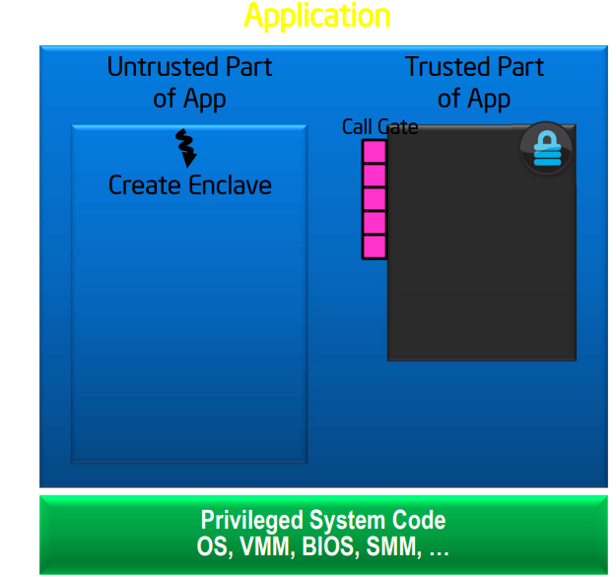
How Secure Enclaves Work
App runs & creates enclave which is placed in trusted memory

Slide 29
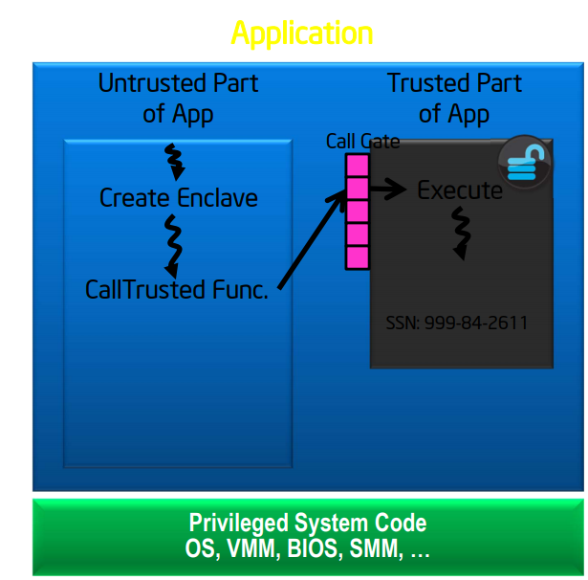
How Secure Enclaves Work
Trusted function (ECALL) is called
Code running inside enclave sees data in clear
External access to data is denied

Slide 30
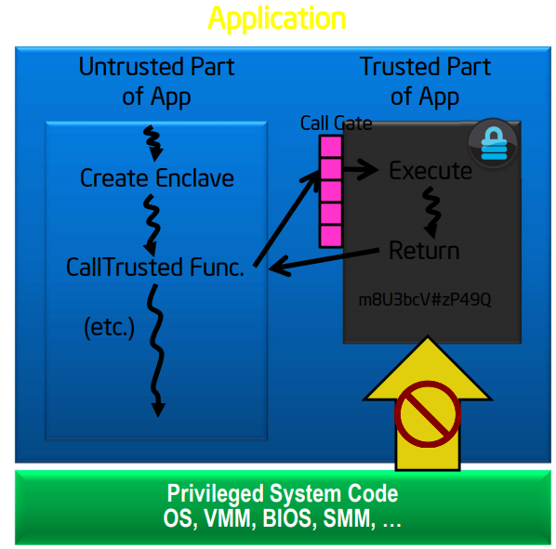
How Secure Enclaves Work
Function returns; enclave data remains in trusted memory

Slide 31
Intel SGX SDK for Linux
Intel provides a Software Development Kit (SDK) for C/C++ programmers
https://software.intel.com/en-us/sgx-sdk
“It is a collection of APIs, libraries, documentation, sample source code, and tools that allows developers to create and debug Intel SGX enabled applications.”

Slide 32
Disclaimer
SGX allows a subset of C/C++ library functions to be used inside the Enclave
List of allowed/disallowed library functions are defined at the Intel SGX Developer Reference
https://download.01.org/intel-sgx/linux-2.4/docs/Intel_SGX_Developer_Reference_Linux_2.4_Open_Source.pdf
Notes:
Strcpy() example

Slide 33
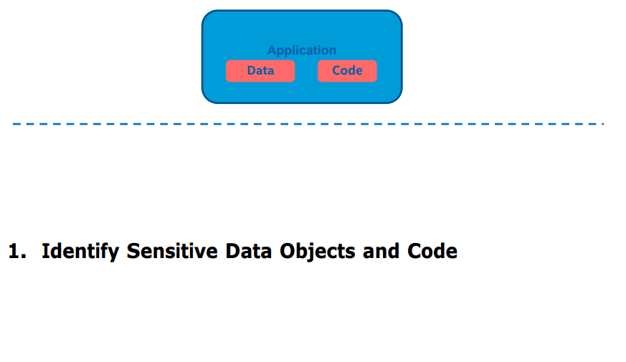
Example: Hardening an Application with SGX

Slide 34
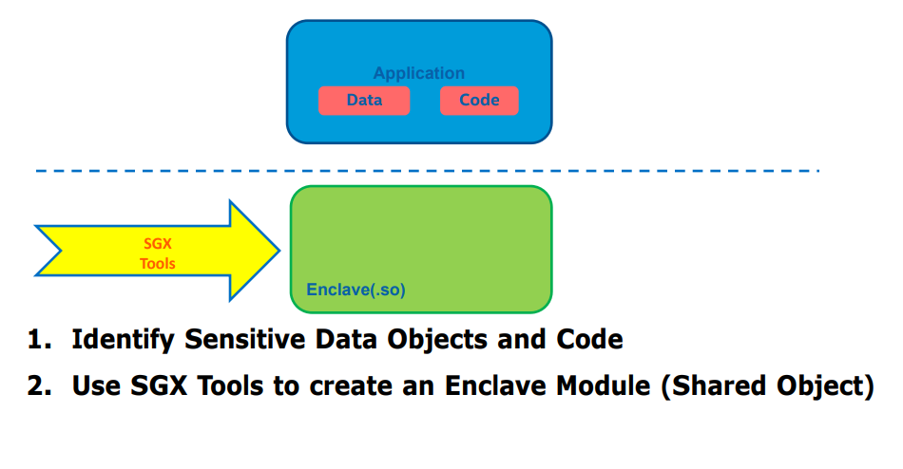
Hardening an Application with SGX

Slide 35
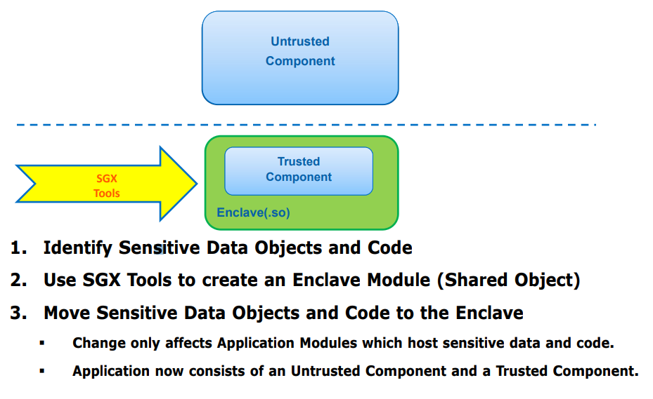
Hardening an Application with SGX

Slide 36
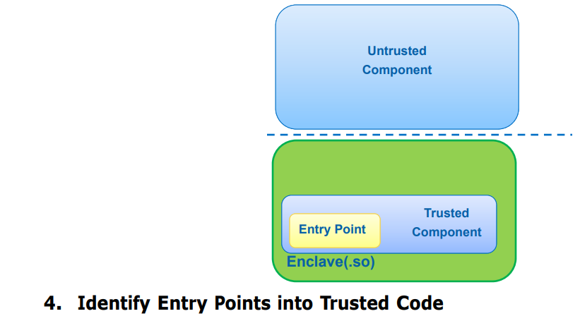
Hardening an Application with SGX

Slide 37
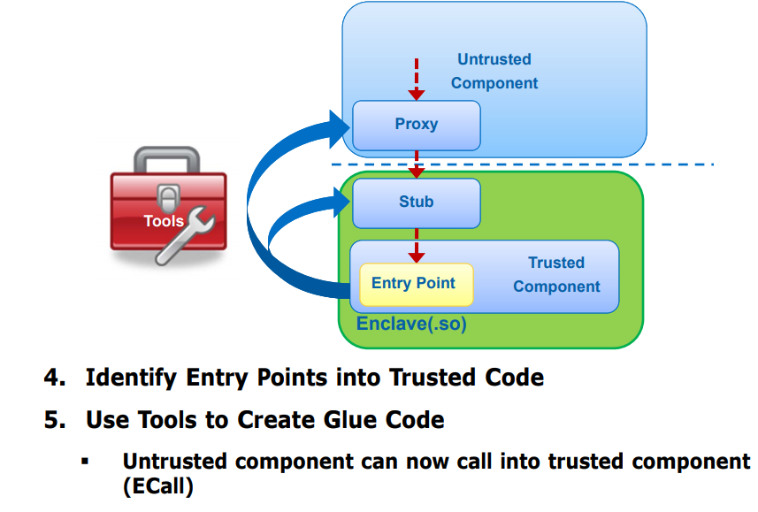
Hardening an Application with SGX

Slide 38
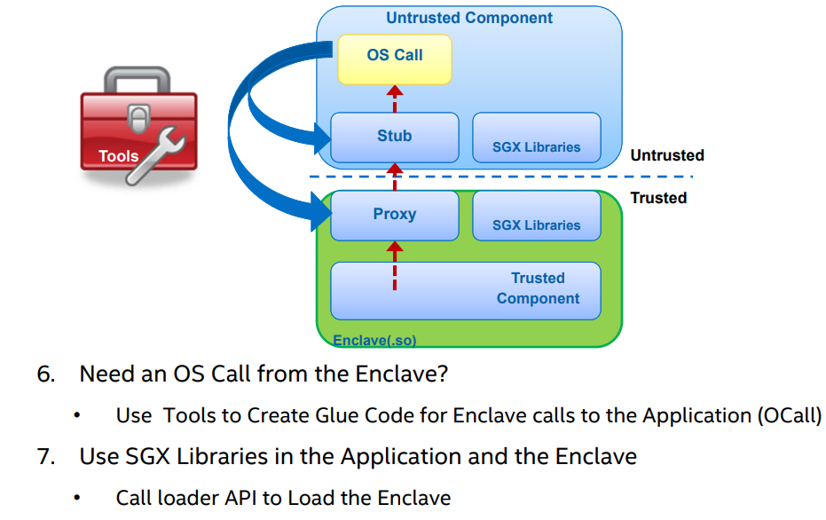
Hardening an Application with SGX

Slide 39

SGX Application Example
Untrusted Code
Enclave
1. Create/Init Enclave
4. OCALL
3. Trusted function
2. ECALL
6. Return
5. Untrusted function
Privileged Code

Slide 40
Enclaves and Objects
An Enclave is like a class.
It can maintain its own state like Objects do with private variables.
ECALLs is like a method, and OCALL is like a return.
Enclave’s property of isolation is like Object Oriented Programming’s principle of encapsulation.
Notes:
Isolation guarantee: the adversary can learn anything about the enclave private variables that it can learn from observing/making arbitrary malicious ecalls

Slide 41
Limitations
SGX does not defend against software side-channel adversary!
Software Side-Channel Adversary: An adversary who can gather statistics from the CPU regarding execution and may be able to use them to deduce characteristics of the software being executed (side-channel analysis)
Gather power statistics
Gather performance statistics including platform cache misses
Gather branch statistics via timing
Gather information on pages accessed via page tables
Notes:
SW side channels are typically difficult to pull off: you have to get lucky and catch the victim as its executing. But in SGX, since we assume a powerful adversary (the OS), it can control the victim's application very precisely.
a.) forcing the victim to de-schedule at the minimum time quantum (allowing the adversary to effectively single-step the victim)
b.) running the victim exactly when all of the attacker's monitoring code is ready to listen
c.) keeping the victim's code out of cache, making it run slower (making measurements easier)

Slide 42
Side-Channel Threats against Interpreted Languages
Data scientists often use interpreted languages (e.g. R, python and etc.) to perform data analysis on sensitive data
R provides convenient libraries for the analysis
How would one know if the R functions are vulnerable against side channel attacks?

Slide 43
Case Study on Scalability of SGX Applications against Side-Channel Threats
R has multiple layers of code base
1. R script written by data scientist
2. Interpreter frontend on parsing R expressions (written in R)
3. Interpreter backend on running counterpart functions (written in C/Fortran)

Slide 44
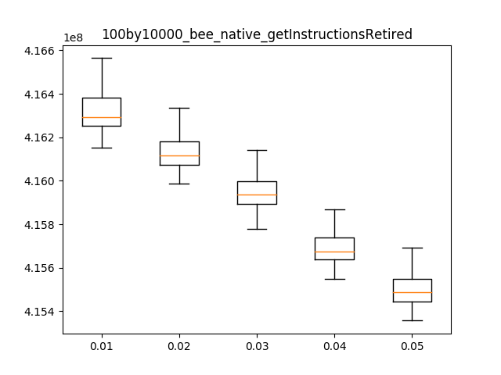
Intel PCM measurements on Genomic Computation
Notes:
X axis: % of NAs
Y axis: Number of total instructions retired

Slide 45
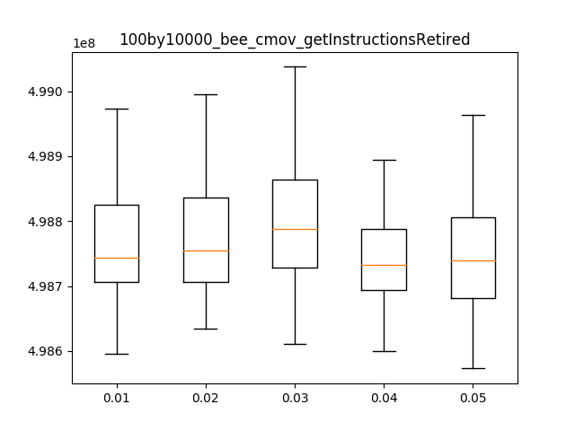
Intel PCM measurements (Cont.)

Slide 47
463.6.1.3
MP3

Slide 48
Multi-party computation
In MP2, we learned how to do a Private Set Intersection with homomorphic encryption.
For this machine problem, we will learn how to run logistic regression, a machine learning algorithm, on a secure enclave.

Slide 49



MP3
  Question: Can data owners collaborate and perform a multi-party computation without explicitly sharing their data?
  Each group will have one of three disjoint datasets (Iris plant dataset with 30 samples each)
Four features were measured from each sample, the length and width of sepals and petals.
Three groups will send their datasets to a server that runs an enclave application. This enclave application receives datasets and perform a machine learning algorithm (logistic regression) on the datasets.
Notes:
Each figure represents Iris setosa, Iris versicolor and Iris virginica from left to right.
The goal of data owners is to develop a model that can classify Iris virginica correctly with four features.

Slide 50
Client
Makes a TLS connection with a server
Sends a dataset (dataseti.csv) to the server
Receives the model from the server as a reply
Tests the model on a test set (testset.csv)

Slide 51
Server
Listens to TLS connections
Receives datasets from three clients
Trains the model inside the Enclave
Sends the model result back to clients

Slide 52
Wolfssl
Embedded, lightweight SSL library for IoTs, embedded systems, or real-time operating systems
Provides support for Intel SGX
We will use their SGX Linux client & server example as a template for our MP
https://github.com/wolfSSL/wolfssl-examples

Slide 53
Disclaimer
The provided template has following limitations.
1. Single Threaded
2. No Filesystem
3. Untrusted Code Must Load Private Key/Certificate Chain
For this MP, protection of key/cert chain is out of scope.

Slide 54
wolfssl template
Composed of two folders
mp3/untrusted
App.c
server-tls.c
client-tls.c
mp3/trusted
Wolfssl_Enclave.c
Wolfssl_Enclave.edl

Slide 55
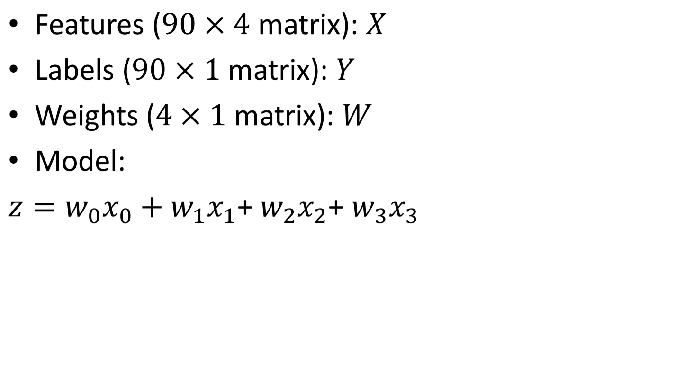
Logistic Regression

Slide 56
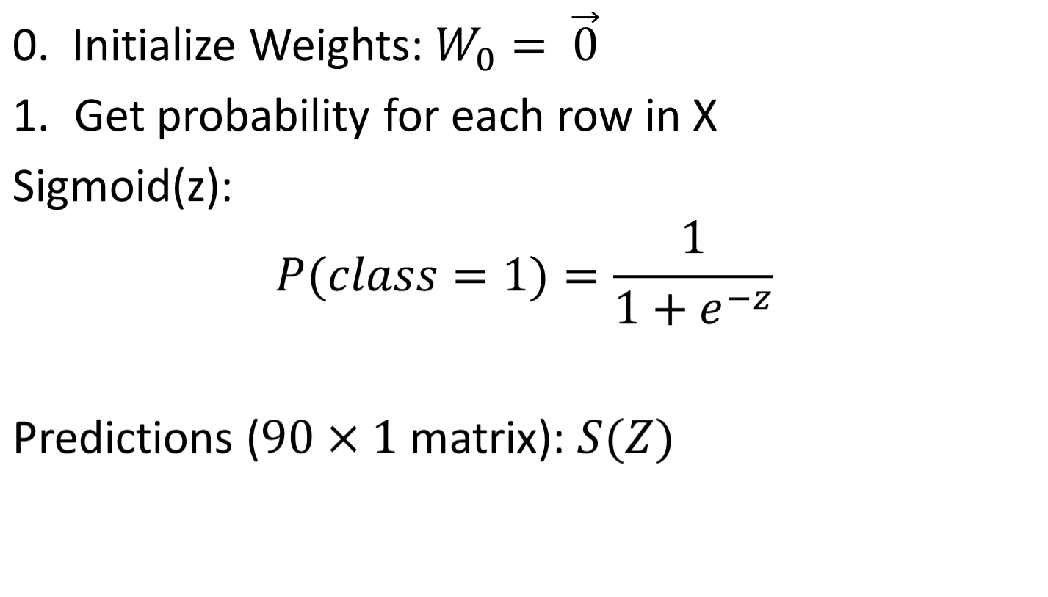
Training the model

Slide 57
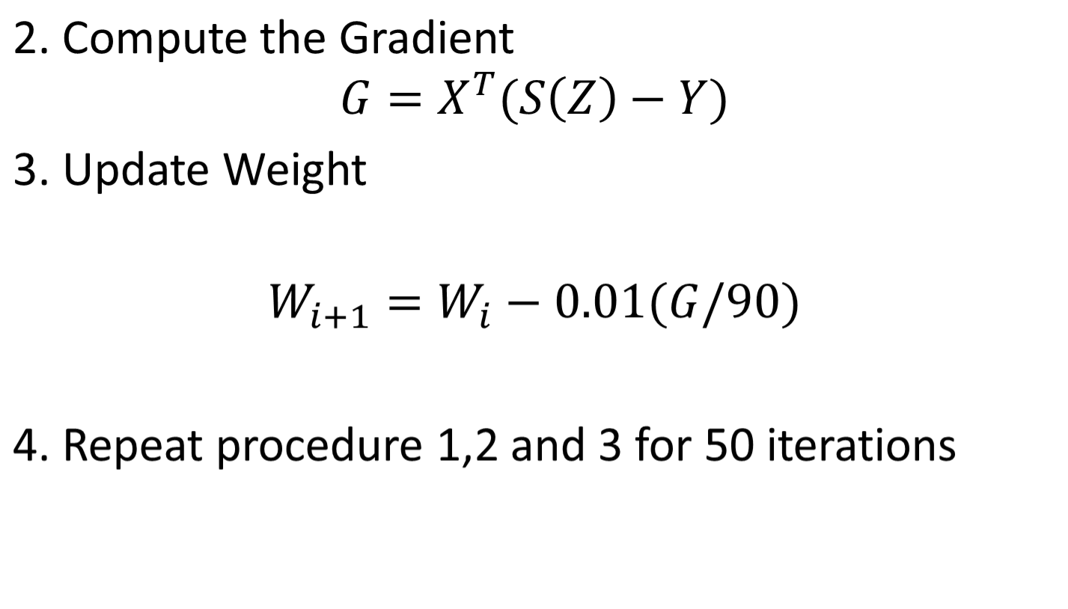
Training the model (cont.)
4. Repeat procedure 1,2 and 3 for 500 iterations

Slide 58
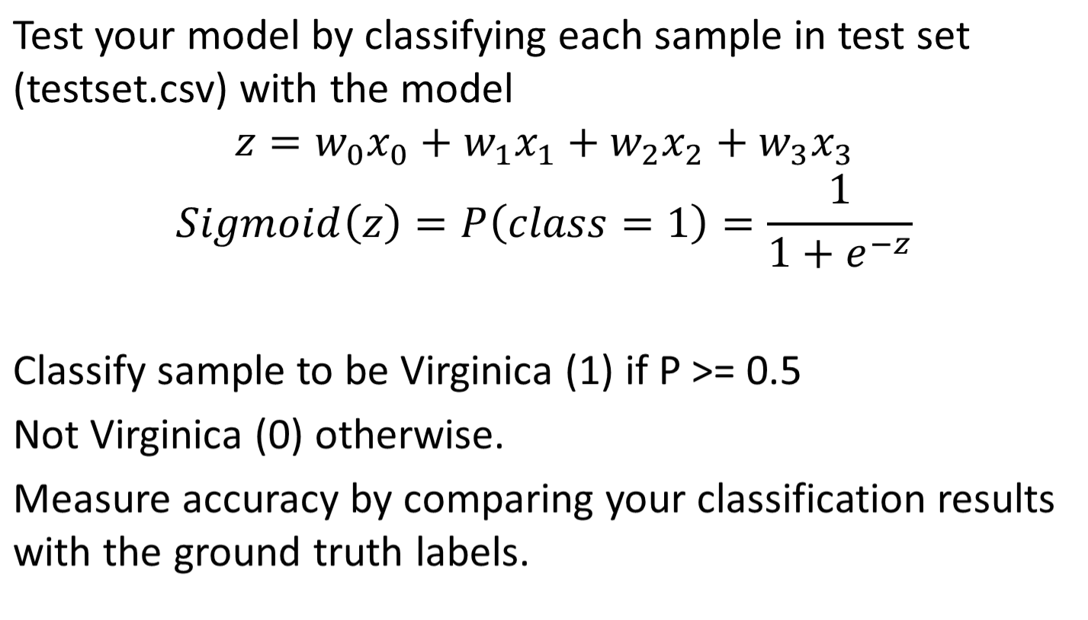
Testing your model

Slide 59
TODOs
Send an email to the course staff (lee559@Illinois.edu) once you formed a group for the MP so that we can designate SGX resources for the group.
Please include [CS463 MP3] in your email title.
Find two other groups with different datasets for Checkpoint 2 early!

Slide 61
Discussion Questions
Should we accept Intel as a root of trust?
What are some use cases for Trusted Computing in addition to disk encryption (e.g. Bitlocker)?

